Slide 1
Hash Tables
0
∅
1
025-612-0001
2
981-101-0002
3
∅
4
451-229-0004
© 2013 Goodrich, Tamassia, Goldwasser
Hash Tables
Notes:
Dictionaries

Slide 2
Why we need Hashing?
Average case runtime
  Array / linked implementations O(N)
  Tree implementation O(log(N))
Ideally a structure ought to allow constant average time insertions/removals/searches

Slide 3


Recall the notion of a Map
Intuitively, a map M supports the abstraction of using keys as indices with a syntax such as M[k].
As a mental warm-up, consider a restricted setting in which a map with n items uses keys that are known to be integers in a range from 0 to N − 1, for some N ≥ n.
© 2013 Goodrich, Tamassia, Goldwasser
Hash Tables
Notes:
Dictionaries

Slide 4
More General Kinds of Keys
But what should we do if our keys are not integers in the range from 0 to N – 1?
  Use a hash function to map general keys to corresponding indices in a table.
  For instance, the last four digits of a Social Security number.
0
∅
1
025-612-0001
2
981-101-0002
3
∅
4
451-229-0004
…
© 2013 Goodrich, Tamassia, Goldwasser
Hash Tables

Slide 5
Introducing Hashing
Hashing is a technique that determines an entry's index using only its search key
Hash function
  Takes a search key and produces the integer index of an element in the hash table
  Search key—maps, or hashes, to the index

Slide 6

Hash Functions and Hash Tables
A hash function h maps keys of a given type to integers in a fixed interval [0, N − 1]
Example:
h(x) = x mod N
is a hash function for integer keys
The integer h(x) is called the hash value of key x
A hash table for a given key type consists of
  Hash function h
  Array (called table) of size N
When implementing a map with a hash table, the goal is to store item (k, o) at index i = h(k)
© 2013 Goodrich, Tamassia, Goldwasser
Hash Tables
Notes:
Dictionaries

Slide 7
SSN Example
We design a hash table for a map storing entries as (SSN, Name), where SSN (social security number) is a nine-digit positive integer
Our hash table uses an array of size N = 10,000 and the hash function
h(x) = last four digits of x
0
∅
1
025-612-0001
2
981-101-0002
3
∅
4
451-229-0004
…
9997
∅
9998
200-751-9998
9999
∅
© 2013 Goodrich, Tamassia, Goldwasser
Hash Tables

Slide 8
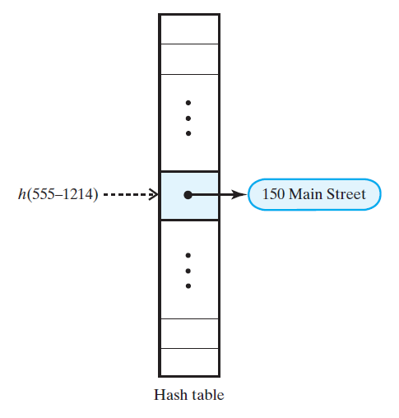
Ideal Hashing

Slide 9
Typical Hashing
Typical hash functions perform two steps
  Convert search key to hash code (an integer).
  Compress hash code into the range of indices for hash table.

Slide 10

Hash Functions
A hash function is usually specified as the composition of two functions:
Hash code:
h₁: keys → integers
Compression function:
h₂: integers → [0, N − 1]
The hash code is applied first, and the compression function is applied next on the result, i.e.,
h(x) = h₂(h₁(x))
The goal of the hash function is to “disperse” the keys in an apparently random way
© 2013 Goodrich, Tamassia, Goldwasser
Hash Tables

Slide 11
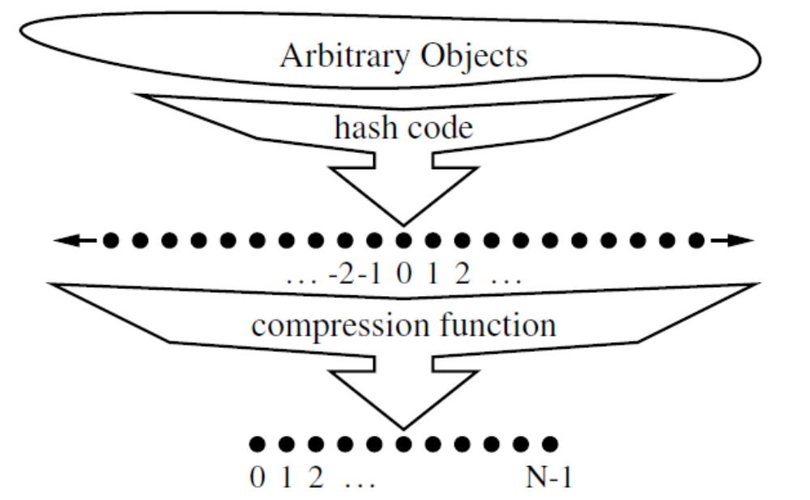
Hash Functions (two parts)
© 2013 Goodrich, Tamassia, Goldwasser
Hash Tables
Notes:
Dictionaries

Slide 12

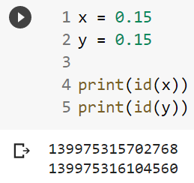
Hash Codes
Memory address:
  We reinterpret the memory address of the key object as an integer; Good in general, except for numeric and string keys
Integer cast:
  We reinterpret the bits of the key as an integer (i.e. Type casting)
  Suitable for keys of length less than or equal to the number of bits of the integer
Component sum:
  We partition the bits of the key into components of fixed length (e.g., 16 or 32 bits) and we sum the components (ignoring overflows)
  Suitable for numeric keys of fixed length greater than or equal to the number of bits of the integer type
© 2013 Goodrich, Tamassia, Goldwasser
Hash Tables
Notes:
Memory address: two instances of objects of the same content have different hash codes! Not ideal
Component sum applies when the number of bits is too long. E.g. 64-bit precision variable, but Python only supports 32-bit hash codes => divide it into 32 32 chunks and hash them individually. Then add or apply exclusive-OR to obtain a hash code
Dictionaries

Slide 13
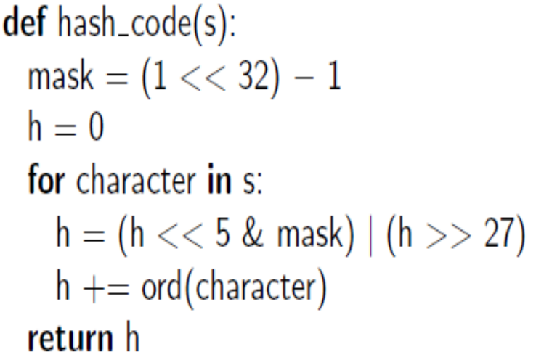
Hash Codes
00111101100101101010100010101000
10110010110101010001010100000111
Polynomial Hash Codes:
  We partition the bits of the key into a sequence of components of fixed length (e.g., 8, 16 or 32 bits)
  a₀ a₁ … a_{n−1}
  We evaluate the polynomial
  p(z) = a₀ + a₁ z + a₂ z² + …
  … + a_{n−1}z^{n−1}
  at a fixed value z, ignoring overflows
  Especially suitable for strings (e.g., the choice z = 33 gives at most 6 collisions on a set of 50,000 English words)
Cyclic-Shift Hash Codes:
‘the’ = int(‘t’) + int(‘h’) * z + int(‘e’) * z²
© 2013 Goodrich, Tamassia, Goldwasser
Hash Tables
Notes:
For set-based hashing, we can use addition or exclusive OR over each hashed items in a set.
Dictionaries

Slide 14
Hash Codes in Python
Python has a built-in function with signature hash(x) that returns an integer value that serves as the hash code for object x.
Only immutable data types are deemed hashable in Python.
Function that computes hash codes can be implemented in the form of a special method named __hash__() within a class.
© 2013 Goodrich, Tamassia, Goldwasser
Hash Tables

Slide 15

Compression Functions
Division:
  h₂ (y) = y mod N
  The size N of the hash table is usually chosen to be a prime
  The reason has to do with number theory and is beyond the scope of this course
Multiply, Add and Divide (MAD):
  h₂ (y) = ((ay + b) mod p) mod N
  p is a prime number larger than N
  a, b are chosen at random from [0,p-1] with a > 0
© 2013 Goodrich, Tamassia, Goldwasser
Hash Tables
Notes:
Dictionaries

Slide 16
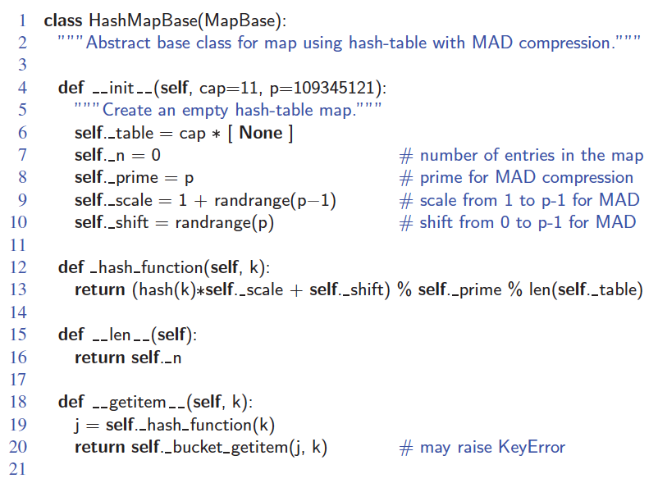
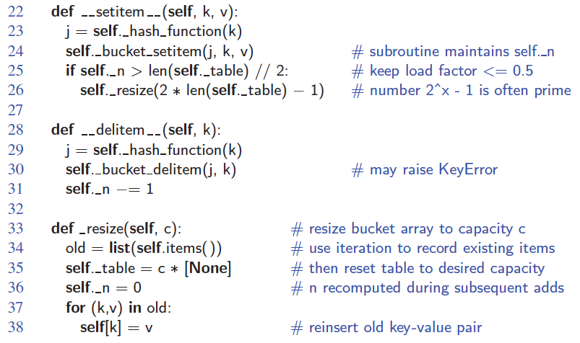
Abstract Hash Table Class
© 2013 Goodrich, Tamassia, Goldwasser
Hash Tables

Slide 17
Hash Functions
A good hash function should
  Minimize collisions
  Be fast to compute
To reduce the chance of a collision
  Choose a hash function that distributes entries uniformly throughout the hash table.

Slide 18
Resolving Collisions
Definition: hash function maps search key into a location already in use in the hash table
Two choices:
  Use another location in the hash table
  Change the structure of the hash table so that each array location can represent more than one value

Slide 19

Collision Handling
(Separate Chaining)
Collisions occur when different elements are mapped to the same cell
Separate Chaining: let each cell in the table point to a linked list of entries that map there
0
∅
1
025-612-0001
2
∅
3
∅
4
451-229-0004
981-101-0004
Separate chaining is simple, but requires additional memory outside the table
© 2013 Goodrich, Tamassia, Goldwasser
Hash Tables

Slide 20
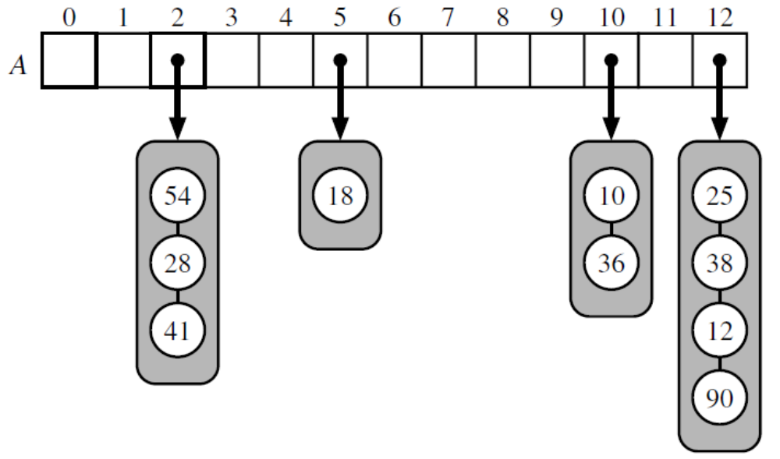
Separate Chaining
© 2013 Goodrich, Tamassia, Goldwasser
Hash Tables
Notes:
Dictionaries

Slide 21
Map with Separate Chaining
Delegate operations to a list-based map at each cell:
Algorithm get(k):
j = h(k) // obtain a bucket index j via hashing
return A[j].get(k)
Algorithm put(k,v):
j = h(k) // obtain a bucket index j via hashing
t = A[j].put(k,v)
if t = null then {k is a new key}
n = n + 1
return t
Algorithm remove(k):
j = h(k) // obtain a bucket index j via hashing
t = A[j].remove(k)
if t ≠ null then {k was found}
n = n - 1
return t
© 2013 Goodrich, Tamassia, Goldwasser
Hash Tables
Notes:
Dictionaries

Slide 22
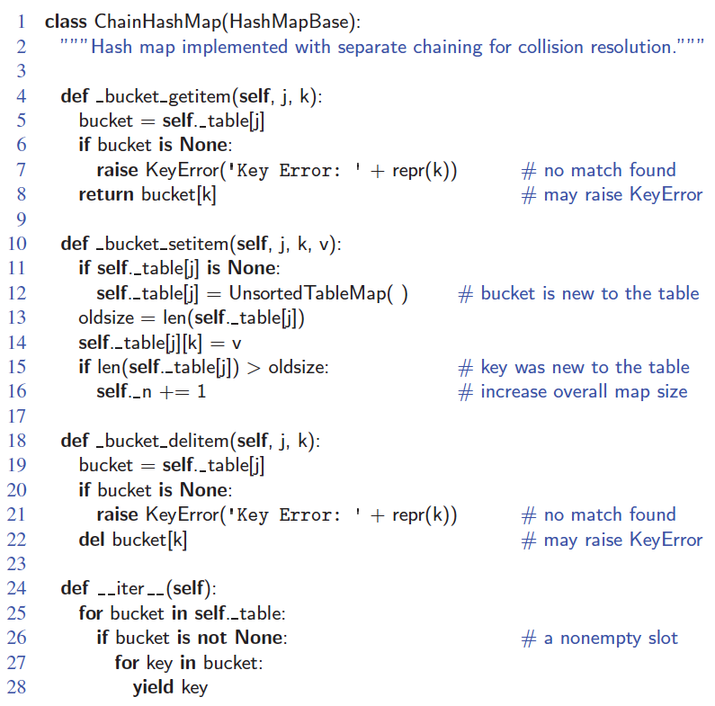
Hash Table with Separate Chaining
© 2013 Goodrich, Tamassia, Goldwasser
Hash Tables
Notes:
Notation:
j: bucket index (integer)
k,v: key-value pair (can be any objects)
Dictionaries

Slide 23
Separate Chaining (Cont.)
In worst case, operations on an individual bucket take time proportional to the size of the bucket.
Assuming we use a good hash function to index the n items of our map in a bucket array of capacity N, the expected size of a bucket is n/N.
If given a good hash function, the core map operations run in O(Ceil(n/N)).
The ratio λ = n/N, called the load factor of the hash table.
© 2013 Goodrich, Tamassia, Goldwasser
Hash Tables

Slide 24
Resolving Collisions
(Linear Probing)
Linear probing
  Resolves a collision during hashing by examining consecutive locations in hash table
  Beginning at original hash index
  Find the next available one (probe sequence)

Slide 25
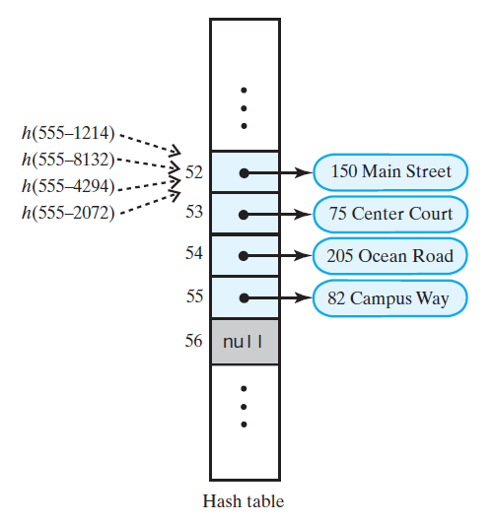
Linear Probing Issues
Issue #1
Clustering

Slide 26
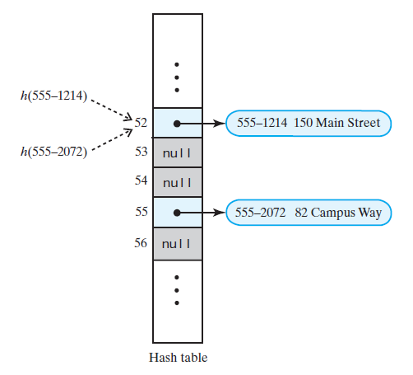
Linear Probing Issues
Issue #2
Entry removals
Delete 555-8132,
555-4294 by setting the entries
to None
What’s the issue?

Slide 27
Linear Probing
Open addressing: the colliding item is placed in a different cell of the table
Linear probing: handles collisions by placing the colliding item in the next (circularly) available table cell
Each table cell inspected is referred to as a “probe”
Colliding items lump together, causing future collisions to cause a longer sequence of probes
Example:
  h(x) = x mod 13
  Insert keys 18, 41, 22, 44, 59, 32, 31, 73, in this order
0
1
2
3
4
5
6
7
8
9
10
11
12
41
18
44
59
32
22
31
73
0
1
2
3
4
5
6
7
8
9
10
11
12
© 2013 Goodrich, Tamassia, Goldwasser
Hash Tables
Notes:
Finding an unused, or open, location in the hash table is called open addressing.
The process of locating an open location in the hash table is called probing
Dictionaries

Slide 28
Clustering
Collisions resolved with linear probing cause groups of consecutive locations in hash table to be occupied
  Each group is called a cluster
Bigger clusters mean longer search times following collision

Slide 29

Search with Linear Probing
Consider a hash table A that uses linear probing
get(k)
  We start at cell h(k)
  We probe consecutive locations until one of the following occurs
    An item with key k is found, or
    An empty cell (None) is found, or
    N cells have been unsuccessfully probed
Algorithm get(k)
i ← h(k) // hashed index i
p ← 0 // number of probs
repeat
c ← A[i]
if c = ∅
return null
else if c.getKey () = k
return c.getValue()
else
i ← (i + 1) mod N // probe
  p ← p + 1 // incr # prob
  until p = N
return null
© 2013 Goodrich, Tamassia, Goldwasser
Hash Tables

Slide 30
Updates with Linear Probing
To handle insertions and deletions, we introduce a special object, called AVAILABLE, which replaces deleted elements
remove(k)
  We search for an entry with key k
  If such an entry (k, o) is found, we replace it with the special item AVAILABLE and we return element o
  Else, we return null
put(k, o)
  We throw an exception if the table is full
  We start at cell h(k)
  We probe consecutive cells:
    A cell i is found that is either empty or stores AVAILABLE. Then cell i is the preferred one to store (k,o). If cell i is marked as AVAILABLE, we need to continue search until either we found an existing k, or
    N cells have been unsuccessfully probed
  We store (k, o) in cell i
© 2013 Goodrich, Tamassia, Goldwasser
Hash Tables

Slide 31
Deletion with linear probing
h(x) = x mod 13
delete 18:
  i = 5 = h(18)
  Found 18 at i, so set it to special token AVAIL (i.e. an empty slot but was occupied)
delete 31
insert 31 (where should 31 be inserted?)
41
18
44
59
32
22
31
73
0
1
2
3
4
5
6
7
8
9
10
11
12
41
44
59
32
22
31
73
0
1
2
3
4
5
6
7
8
9
10
11
12
AVAIL
41
44
59
32
22
73
0
1
2
3
4
5
6
7
8
9
10
11
12
AVAIL
© 2013 Goodrich, Tamassia, Goldwasser
Hash Tables
Notes:
If we encounter AVAIL, this doesn’t tell whether a key exists or not => continue probing
Dictionaries

Slide 32
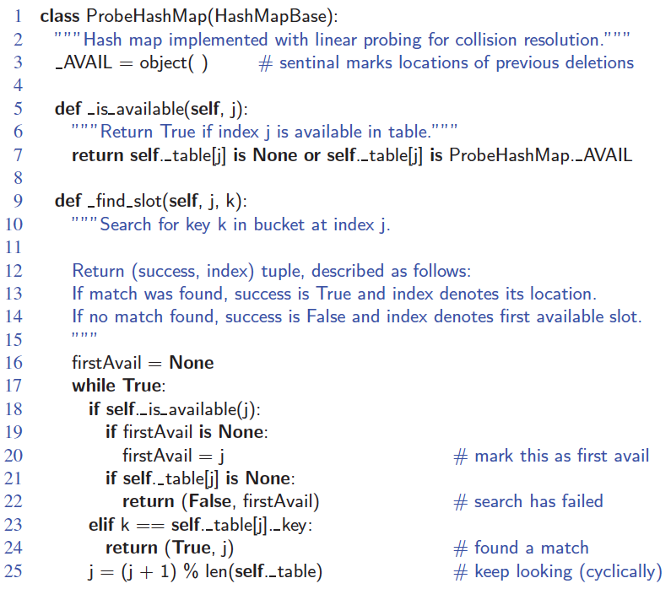
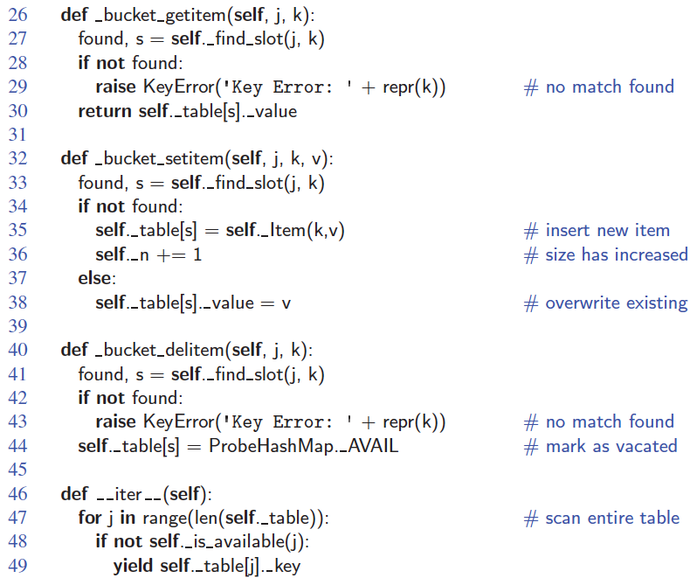
Hash Table with Linear Probing
© 2013 Goodrich, Tamassia, Goldwasser
Hash Tables

Slide 33
Quadratic Probing
Linear probing looks at consecutive locations beginning at index k
Quadratic probing, considers the locations at indices k + j²
  Uses the indices k, k + 1, k + 4, k + 9, …

Slide 34
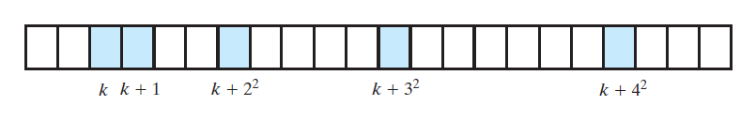
Quadratic Probing

Slide 35
Quadratic Probing Pros and Cons
Advantages
  Avoids clustering
Disadvantages
  Creates secondary clustering
    A different pattern of filled array locations
  An empty location may not be found even if one exists
    If the load factor is 0.5 or more

Slide 36
Double Hashing
Linear and quadratic probing
  Add increments to k to define a probe sequence
  Both are independent of the search key
Double hashing
  Computes increments via a second hash function
  => key-dependent method

Slide 37

Double Hashing
Double hashing uses a secondary hash function d(k) and handles collisions by placing an item in the first available cell of the series
(i + jd(k)) mod N
for j = 0, 1, … , N − 1
The secondary hash function d(k) cannot have zero values
The table size N must be a prime to allow probing of all the cells
Common choice of compression function for the secondary hash function:
  d₂(k) = q − k mod q
where
  q < N
  q is a prime
The possible values for d₂(k) are
1, 2, … , q
© 2013 Goodrich, Tamassia, Goldwasser
Hash Tables
Notes:
i = h(k)
Dictionaries

Slide 38
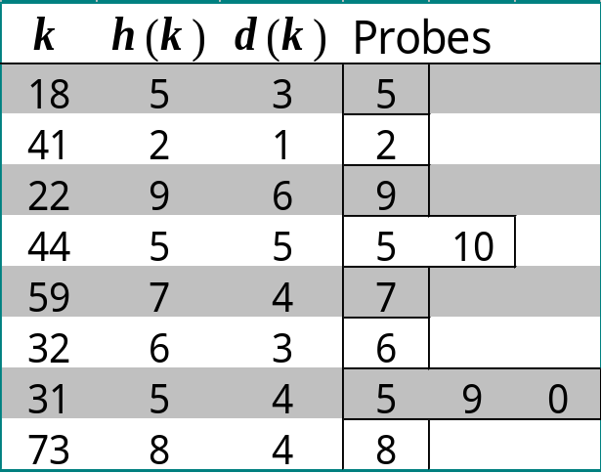
Example of Double Hashing
Consider a hash table storing integer keys that handles collision with double hashing
  N = 13
  h(k) = k mod 13
  d(k) = 7 − k mod 7
Insert keys 18, 41, 22, 44, 59, 32, 31, 73, in this order
Use AVAIL to mark deleted entry
0
1
2
3
4
5
6
7
8
9
10
11
12
31
41
18
32
59
73
22
44
0
1
2
3
4
5
6
7
8
9
10
11
12
© 2013 Goodrich, Tamassia, Goldwasser
Hash Tables

Slide 39
Load Factor (again)
The load factor λ of a hashing table expresses how “full” the table has become
λ = # of entries / table capacity
  Example
    capacity = 11
    items stored = 7
    λ = 7/11 = 0.64
λ should always be kept below 0.75 to reduce collision rate

Slide 40
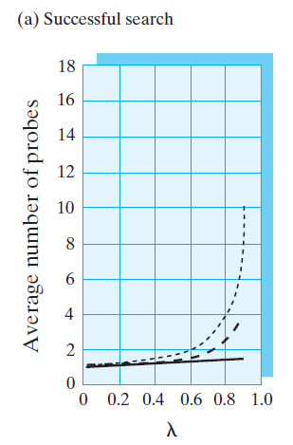

Collision Resolution
Successful Searches

Slide 41
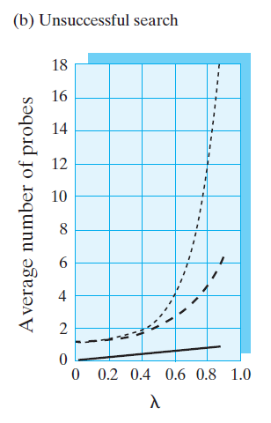
Collision Resolution
Unsuccessful Searches

Slide 42
Rehashing
Maximum load factor, based on experimental data:
  0.5 for open addressing schemes
  0.9 for separate chaining
If the load factor is above that threshold, then the table should be resized
  New table should be at least double the old table so that the time cost can be amortized
  Hash function should be modified
  Rehash the data – take each item out of the old array and insert it into the new one using the new hash function

Slide 43
Comparison of Hash Table & BST
BST HashTable
Average Speed O(log₂N) O(1)
Find Min/Max Yes No
Items in a range Yes No
Sorted Input Very Bad No problem
Use HashTable if
  there is any suspicion of SORTED input, and
  NO ordering is required.

Slide 44

Performance of Hashing
In the worst case, searches, insertions and removals on a hash table take O(n) time
The worst case occurs when all the keys inserted into the map collide
The load factor α = n/N affects the performance of a hash table
Assuming that the hash values are like random numbers, it can be shown that the expected number of probes for an insertion with open addressing is
1 / (1 − α)
The expected running time of all the dictionary ADT operations in a hash table is O(1)
In practice, hashing is very fast provided the load factor is not close to 100%
Applications of hash tables:
  small databases
  compilers
  browser caches
© 2013 Goodrich, Tamassia, Goldwasser
Hash Tables
Notes:
Dictionaries

Slide 45
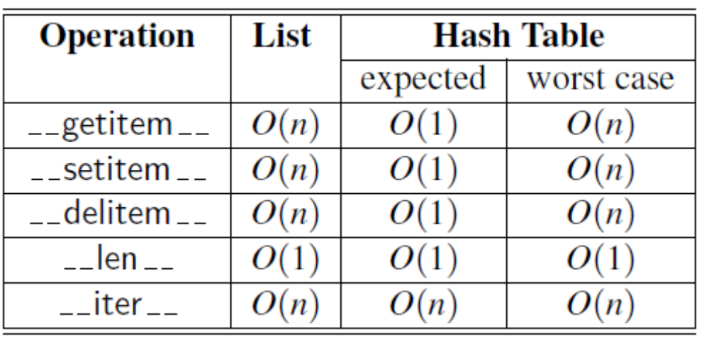
Performance of Hashing (Cont.)
© 2013 Goodrich, Tamassia, Goldwasser
Hash Tables

